Slide 1
Team presentation-6 NTCIR-15 Dialogue Evaluation Task
組員 : 黃彥鈞、黃顗亘、鄭宇雅、廖容毅

Slide 2
Summary
In last presentation, we introduced how to generate the probability distribution of each utterances of the Dialogue Dataset, how to build a model that can directly predict probability distribution, and implement customize loss function.
In this presentation, we will talk about the output evaluation process and NCTIR-14 (STC) Chinese nugget detection subtask history information.

Slide 3
Outlines
Evaluation process
NTCIR-14 STC ND

Slide 4
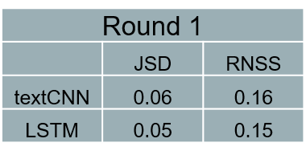
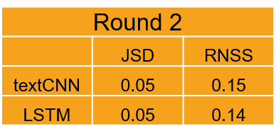
Evaluation process I
CNUG0 CNUG* CNUG CNaN HNUG HNUG* HNaN
1
features
0.85
0
0.15
0
0
0
0
2
features
0
0
0
0
0.71
0.2
0.09
3
features
0
0.7
0.2
0.1
0
0
0
dNN
1
features
0.85
0
0.15
0
0
0
0
2
features
0
0
0
0
0.71
0.2
0.09
Output dev probability estimation
3
features
0
0.7
0.2
0.1
0
0
0
Calculate divergence scores between Estimation and Truth

Slide 5
Evaluation process II
Official
Evaluation
CNUG0 CNUG* CNUG CNaN
1
features
0.85
0
0.15
0
Customer
Nugget
Subset
dNN_01
JSD, RNSS
3
features
0
0.7
0.2
0.1
Submission
Output and
Bind the data
Calculate
respectively
HNUG HNUG* HNaN
2
features
0.71
0.2
0.09
Mean result
Helpdesk
Nugget
Subset
dNN_02
JSD, RNSS
4
features
0.1
0.6
0.3

Slide 6
NTCIR-14 STC ND I
We surveyed the NTCIR-14 STC Nugget Detection subtask page in order to enlarge the dataset, and we found out that the NTCIR-14 training dataset are totally as same as our current dataset (even the label type and evaluation method)
So, we then surveyed the proceeding overview paper of the STC task to dive into the former scores and methods of last year’s Nugget Detection subtask participants.

Slide 7
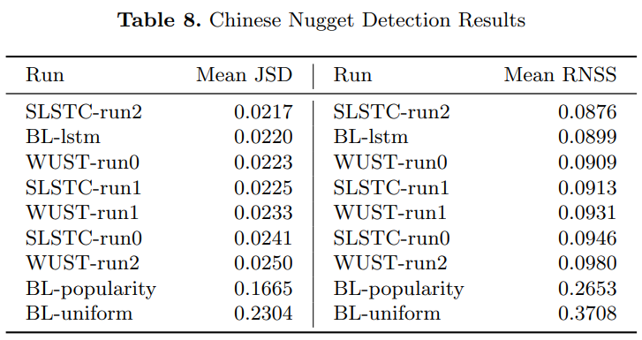
NTCIR-14 STC ND II
NTCIR-14 testing results (noted that BL is an abbreviation of baseline which was released by organizer)

Slide 8
NTCIR-14 STC ND III
BL-lstm : A baseline model 4 which leverages Bidirectional Long Short-term Memory
BL-uniform : A baseline model which always predict the uniform distribution.
BL-popularity : A baseline model which predicts the probability of the other labels except the most popular label as 0.

Slide 9
NTCIR-14 STC ND IV
Top 3 methods :
SLSTC Run-2: Bi-LSTM Baseline with BERT Embedding
BL-lstm
WUST Run-0 : Inserting an extra attention layer into the LSTM BL before the output layer

